Slide 1

How Dangerous is NYC Compared to the Rest of the Country
Jack Grossi
Fall 2022
Data Visualization

Slide 2
Abstract
A hot topic currently in the media is how dangerous New York has become in recent years. We’ve all heard it, “New York is as bad as it was in the 90’s” or any other decade. But how valid is this claim? This project aims to analyze crime rates in New York City and compare it to rural, suburban, and other urban areas in the United States to see how much better or worse New York City ranks among them. The data used for this project will be sourced from the CDC’s Underlying Causes of Death database (CDC Wonder).
We will use visualization techniques to aid in defining “danger” for the purposes of this discussion. They will also provide us a means of seeing exactly how NYC compares to the rest of the country.

Slide 3
Preprocessing
CDC Wonder is queried to create relevant datasets
Address Tableau dropping leading zeros
Ex: 01001 -> 1001
RIGHT("00000" + STR([County Code]),5)

Slide 4
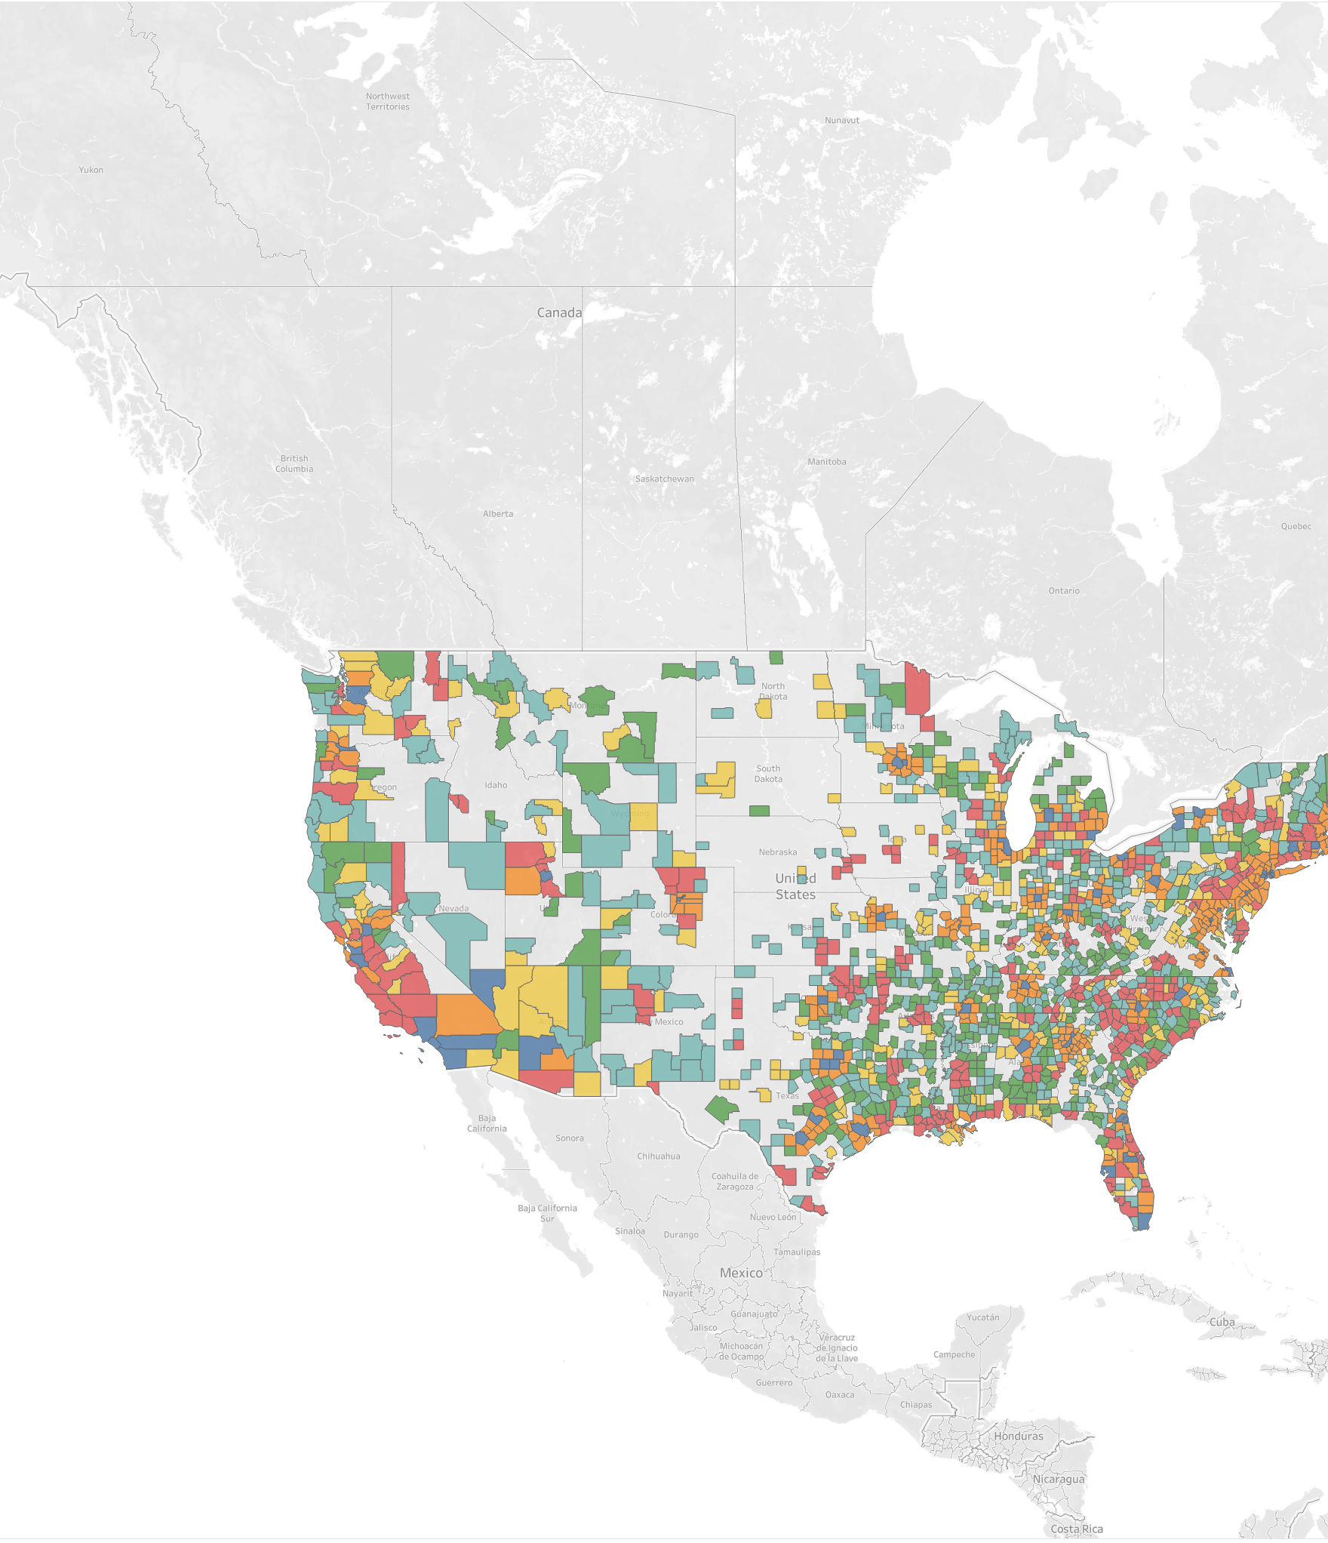
About the data
We have data for 1,710 counties in 2020 including Alaska and Hawaii
Data is grouped by county, urbanization level, and year
We have data for 2,454 counties for full range from 1999-2020
Counties with less than 10 data points are dropped

Slide 5
Defining Urbanization
The large central metro category contains counties in metropolitan statistical areas (MSAs) of one million or more population that have been identified by NCHS classification rules as central because they contain all or part of a principal city of the area.
The large fringe metro category contains the remaining counties (similar to suburbs) in MSAs of one million or more.
Counties in MSAs of 250,000 to 999,999 population are assigned to the medium metro category and counties in MSAs with populations under 250,000 are assigned to the small metro category.
Nonmetropolitan counties that are designated by the Office of Management and Budget as belonging to a micropolitan statistical area are assigned to the micropolitan category and the remaining nonmetropolitan counties are assigned to the noncore category.
Large Central Metro
Large Fringe Metro
Medium Metro
Small Metro
Micropolitan (Nonmetro)
NonCore (Nonmetro)
Urban
Rural

Slide 6
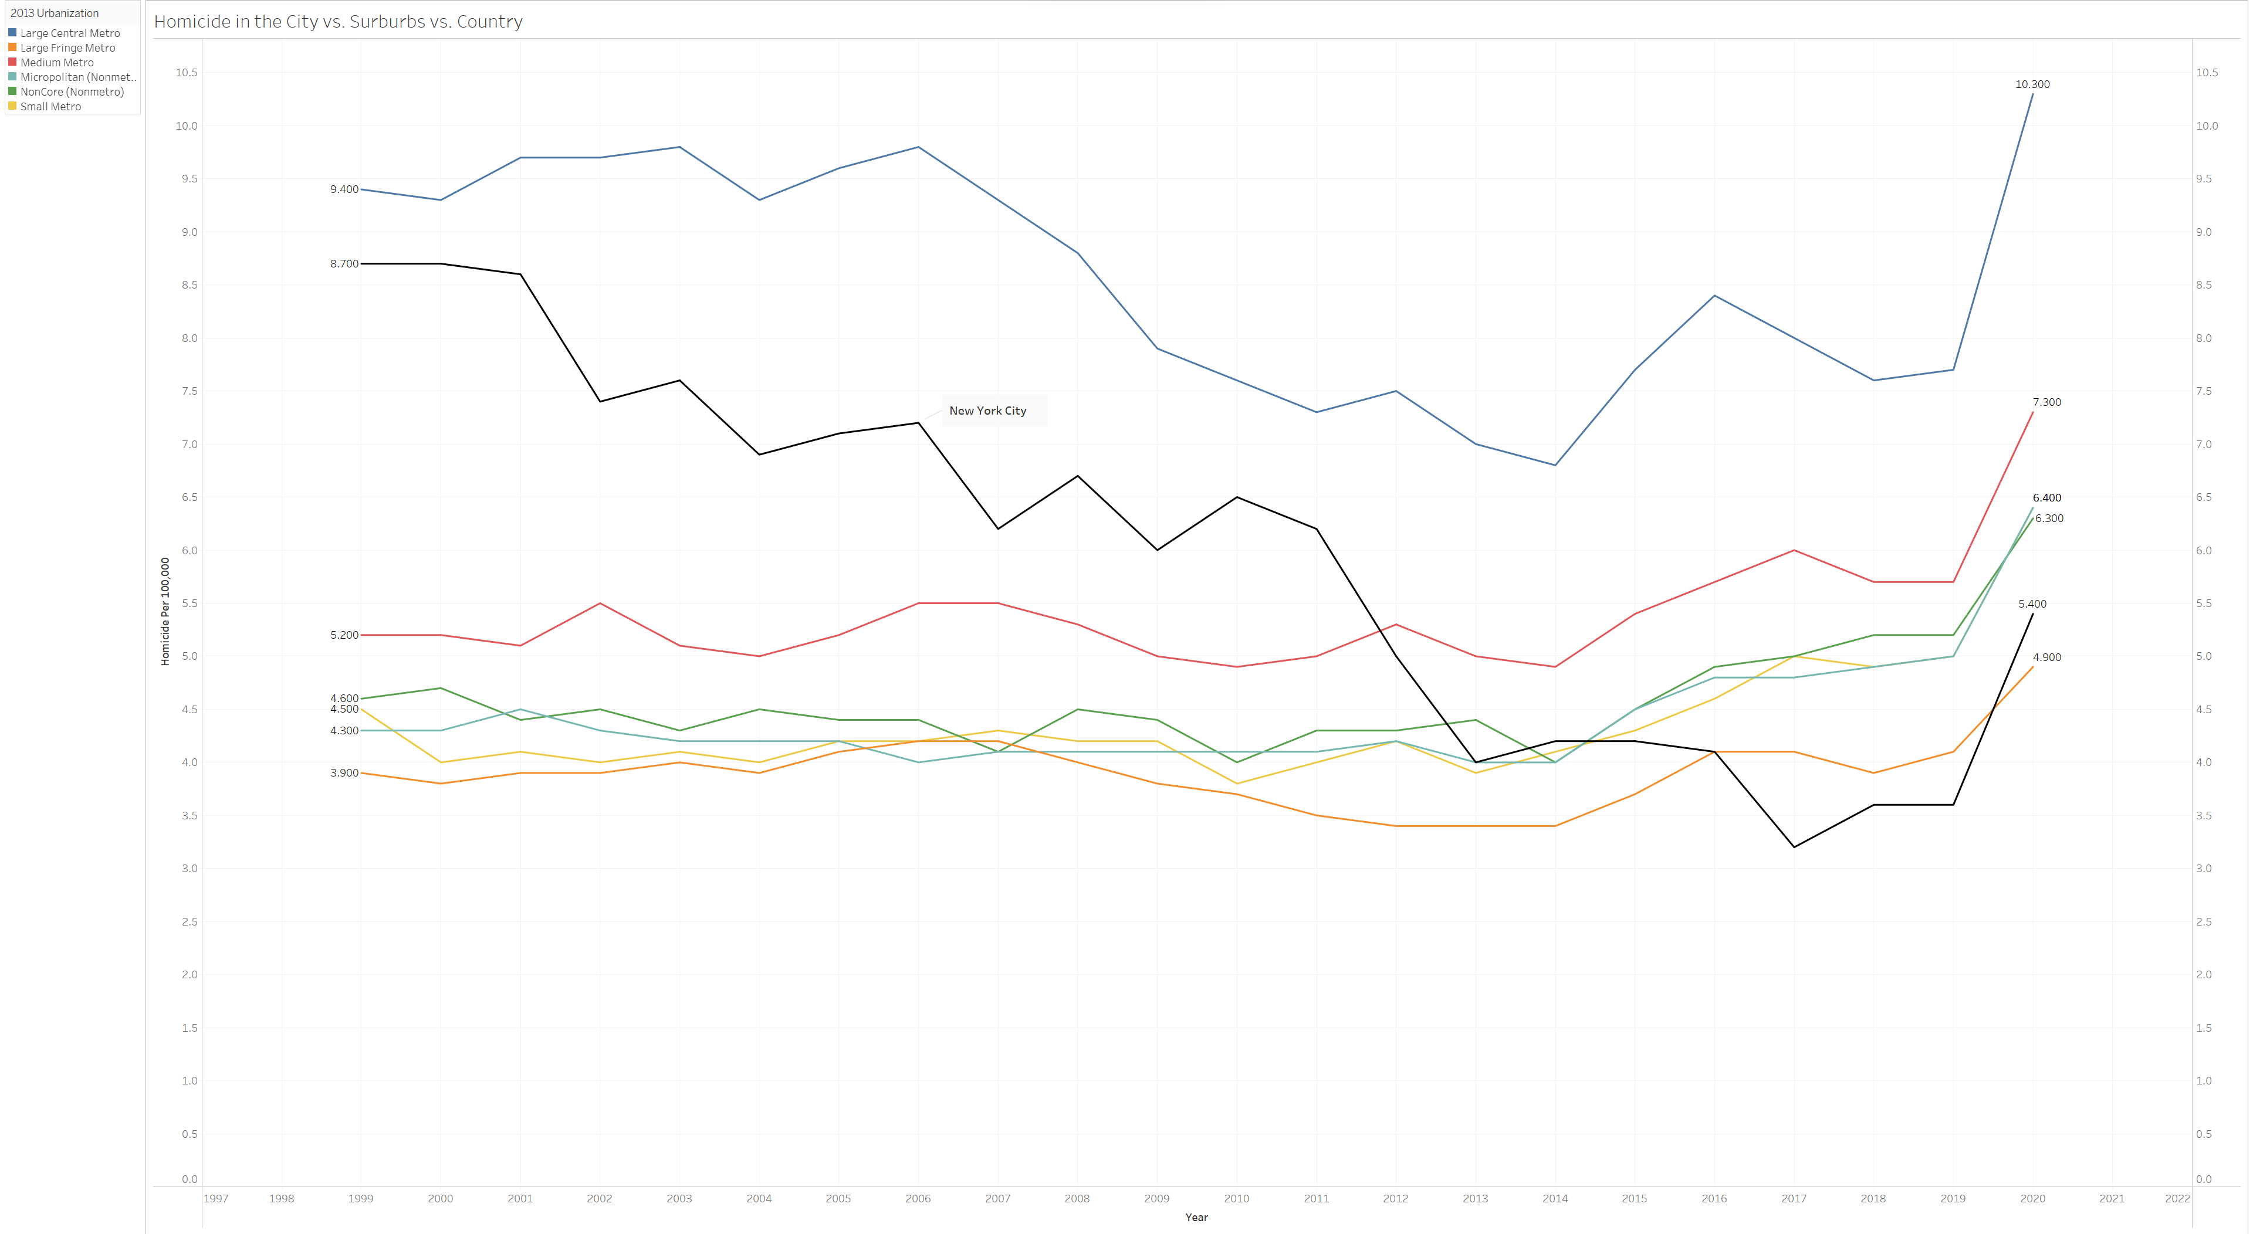

Slide 7
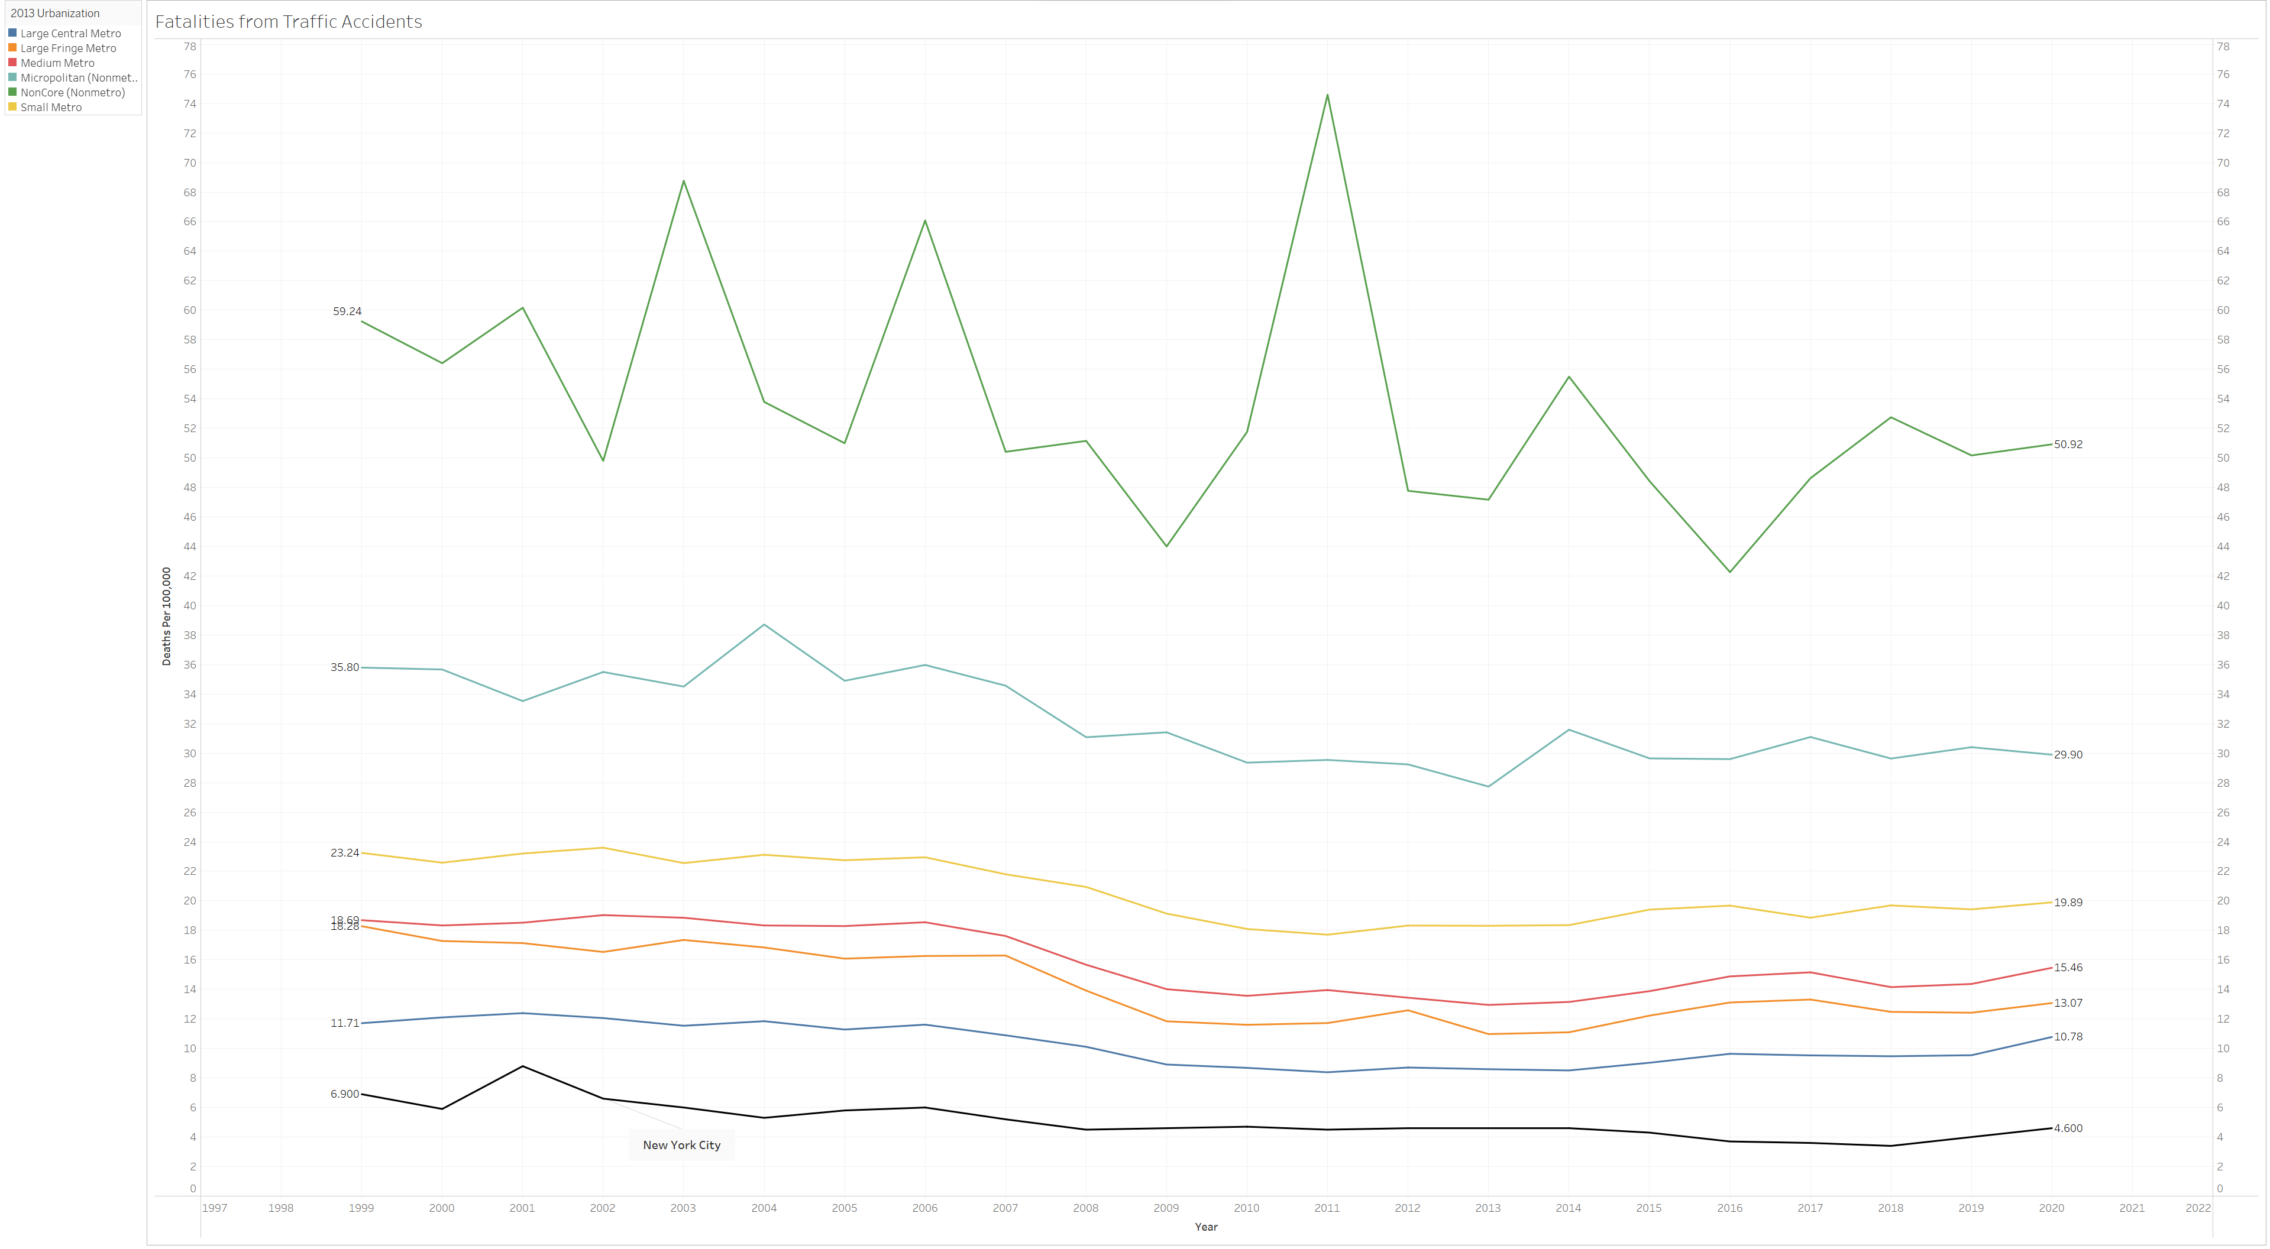

Slide 8
How to define “Danger”
Categories like Assault, Traffic Accidents, Legal Intervention, etc are kept in
Categories Removed:
Accidental Poisoning by Noxious Substance
Falls
Intentional Self-Harm
Complications of medical and surgical care
Sequelae of external causes of morbidity and mortality

Slide 9
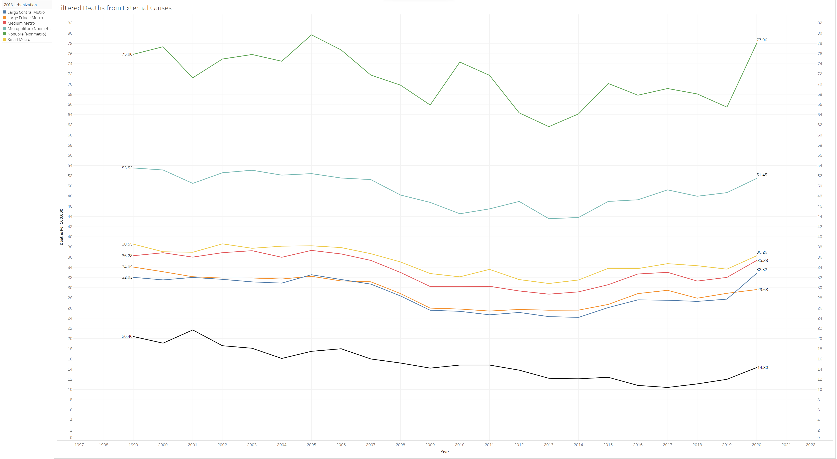

Slide 10
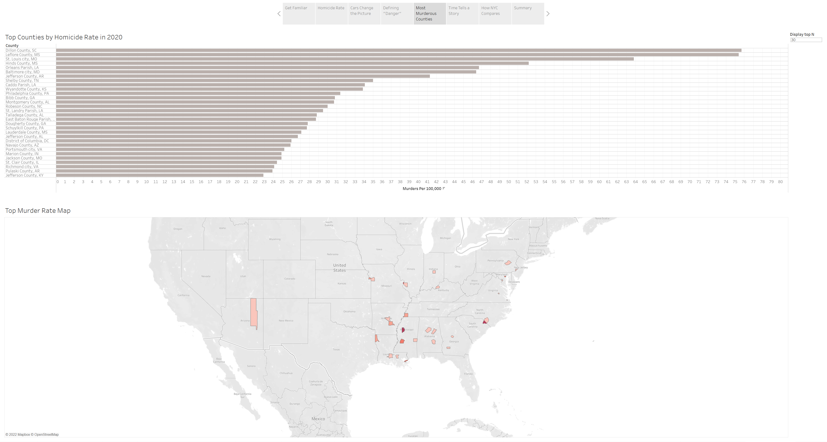

Slide 11
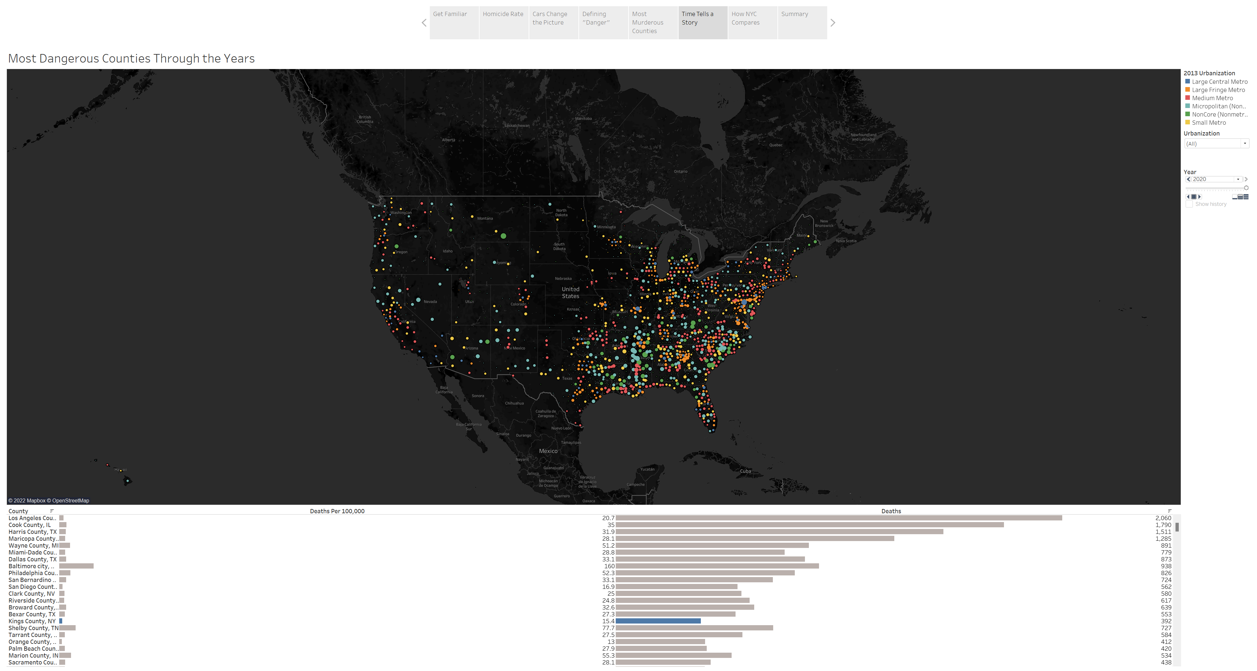

Slide 12
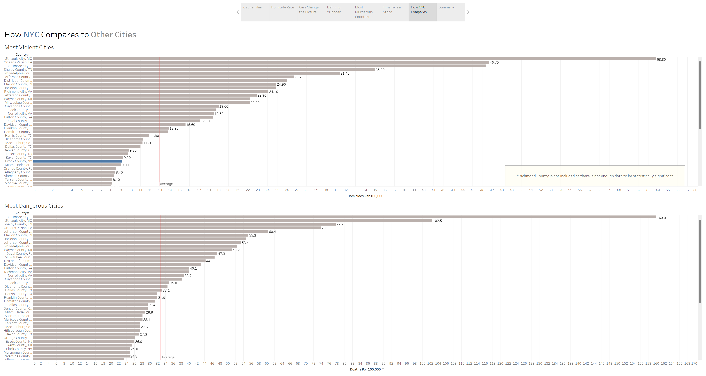

Slide 13
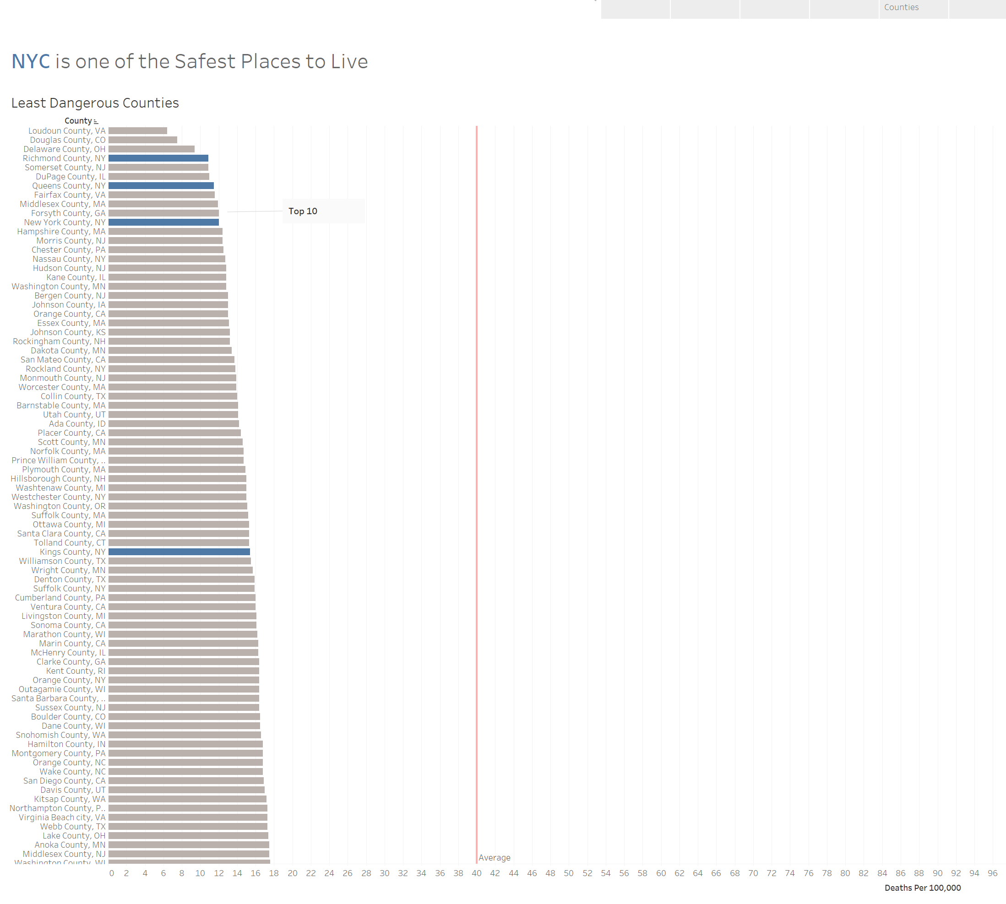

Slide 14
Conclusion
2 of the 5 Counties of NYC are among the top 10 safest to live based on our definition of danger. 3 are among the top 11.
Richmond County
Queens County
New York County
Additionally, when compared to other Large Central Metro areas, NYC is nowhere near the top counties of 2020.

